Slide 1
Control System Design (MECH 473) Session #3 Dynamical Modeling
Presented by:
Hamid Ebrahimi Orimi
h.e.orimi@hotmail.com

Slide 2
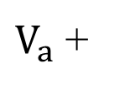


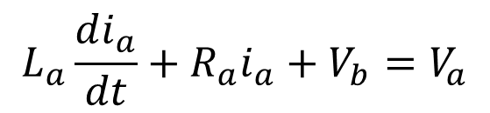
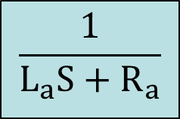
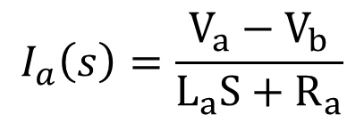


Electronical Block Diagram
$$L_{a}\frac{di_{a}}{dt}+R_{a}i_{a}+V_{b}=V_{a}$$
$$L_{a}SI_{a}\left(s\right)+R_{a}I_{a}\left(s\right)=V_{a}−V_{b}$$
$$V_{b}=K_{e}ω$$
$$I_{a}\left(s\right)=\frac{V_{a}−V_{b}}{L_{a}S+R_{a}}$$
$V_{a}$ +
$$\frac{1}{L_{a}S+R_{a}}$$
$$I_{a}$$
$${−V}_{b}$$

Slide 3

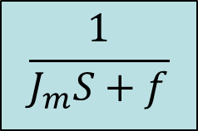
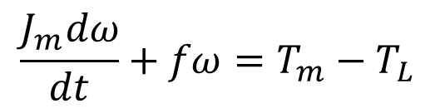
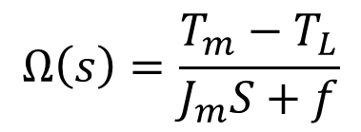
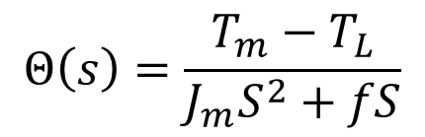

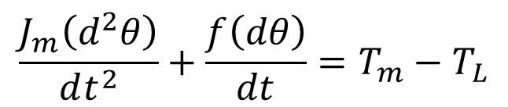




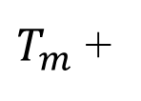


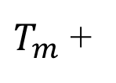

Mechanical Block Diagram
$$\frac{J_{m}\left(d^{2}θ\right)}{dt^{2}}+\frac{f\left(dθ\right)}{dt}=T_{m}−T_{L}$$
$$\frac{J_{m}dω}{dt}+fω=T_{m}−T_{L}$$
$$J_{m}S^{2}Θ\left(s\right)+fSΘ\left(s\right)=T_{m}−T_{L}$$
$$J_{m}SΩ\left(s\right)+fΩ\left(s\right)=T_{m}−T_{L}$$
$$T_{m}=K_{t}i_{a}$$
$$Θ\left(s\right)=\frac{T_{m}−T_{L}}{J_{m}S^{2}+fS}$$
$$Ω\left(s\right)=\frac{T_{m}−T_{L}}{J_{m}S+f}$$
$T_{m}$ +
$$\frac{1}{J_{m}S+f}$$
$$Θ$$
$T_{m}$ +
$$\frac{1}{S}$$
$$\frac{1}{J_{m}S+f}$$
$$Ω$$
$$− T_{L}$$
$$−T_{L}$$

Slide 4
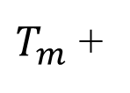





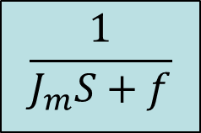



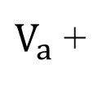

Combination
$V_{a}$ +
$T_{m}$ +
$$\frac{1}{J_{m}S+f}$$
$$Θ$$
$$\frac{1}{L_{a}S+R_{a}}$$
$$I_{a}$$
$$K_{t}$$
$$\frac{1}{S}$$
$${−V}_{b}$$
$$− T_{L}$$
$$J_{M}S$$
$$K_{e}$$

